Slide 1
National Central University

Slide 2
學生事務處 Office of Student Affairs
Military Education Office
Division of Student Conduct & Housing Service
Health Center
Counseling Center
Extracurricular Activities Office
Career Center

Slide 3
Office of Student Dormitory Service

Slide 4
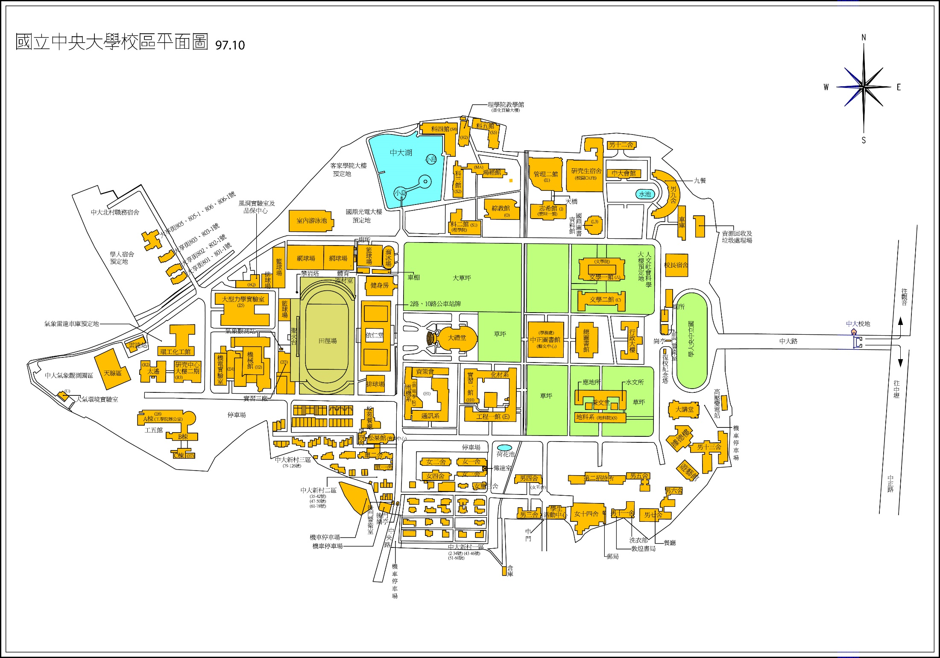
You are here

Slide 5
Division of Student Conduct & Housing Service

Slide 6
You are here

Slide 7
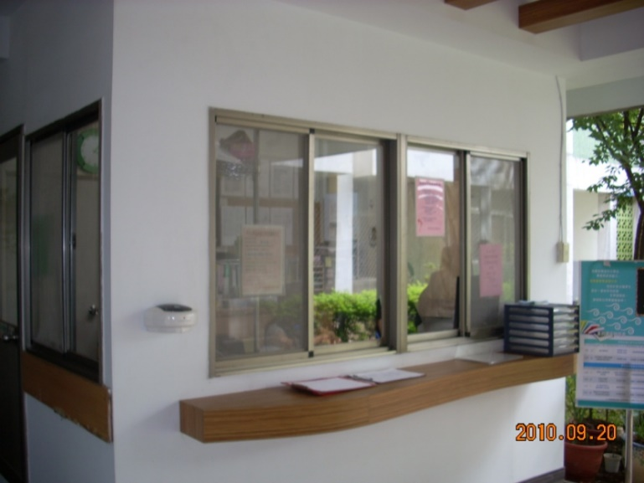
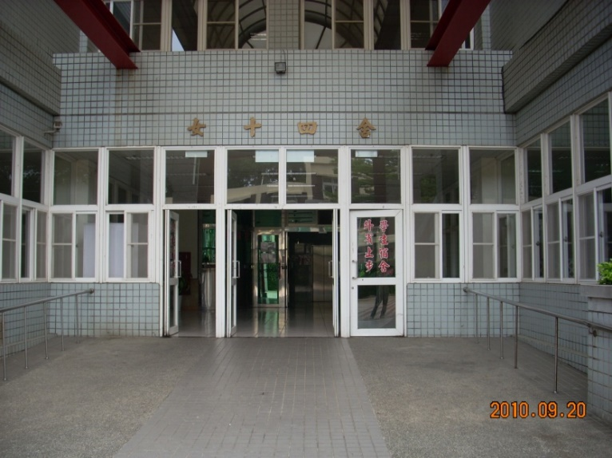
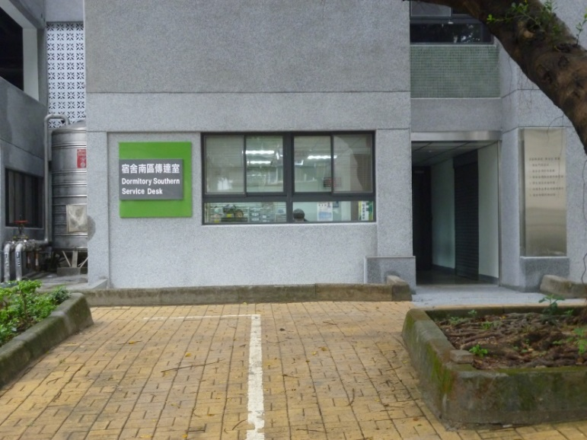
The Dorm Service Desk Offers
North Dorm Service Desk
West Dorm Service Desk
East Dorm Service Desk
South Dorm Service Desk

Slide 8
How to Contact Us (24hr)
Area | Phone Number | Dormitory
North dorm service desk(BM) | 0919-019-714 | BM、B12 9A、9B
South dorm service desk(B5) | 0919-019-564 | B6 B7、B13
East dorm service desk(G14) | 0919-019-864 | B11、B5、G14 GM、GFM
West dorm service desk(G1-G4) | 0919-019-964 | G1、G2 G3、G4 G5、B3

Slide 9
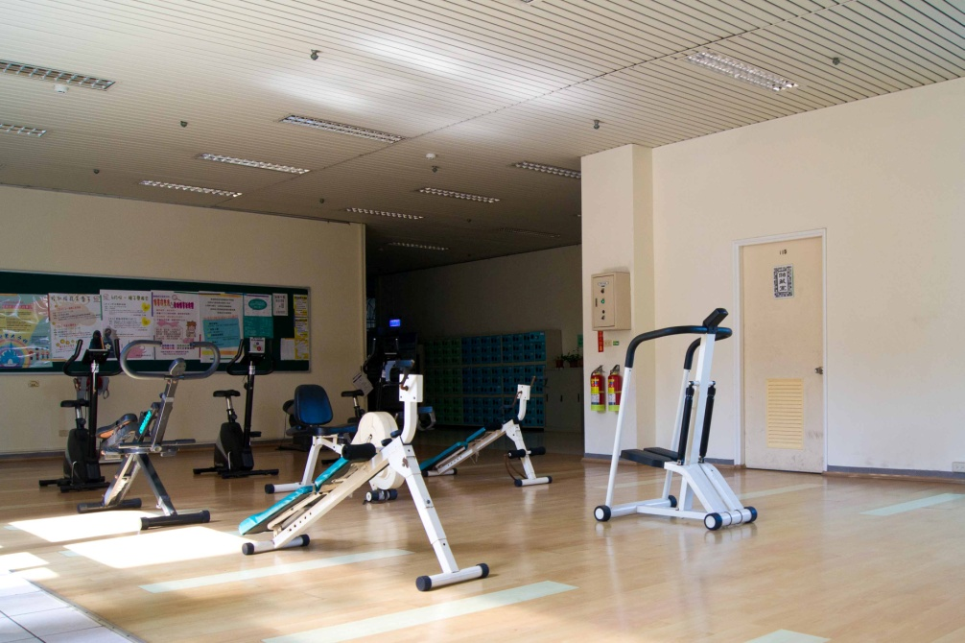
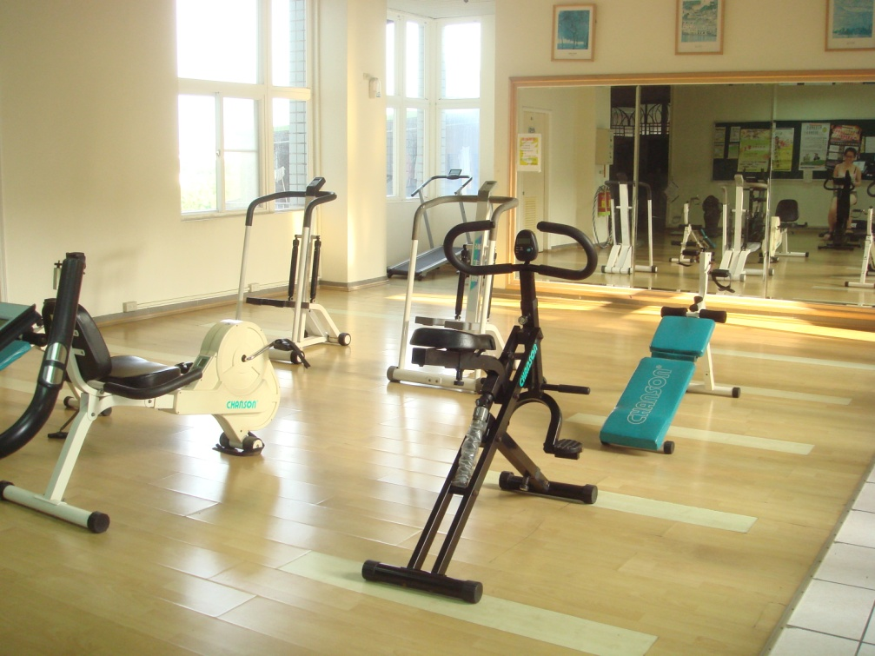
Dormitory, G14 (gym)
Please sign up at the service counter on the first floor
in order to use the treadmill, others may be used freely.

Slide 10
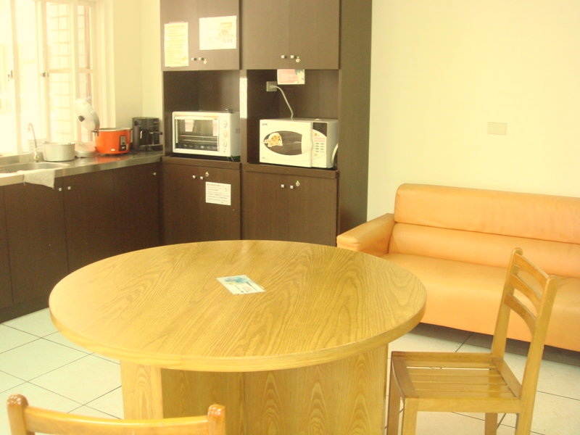
Kitchen (open at 8:00 ~ 23:00)
Every kitchen has a refrigerator, rice cooker, oven, microwave.

Slide 11
Rules
1. Follow the guidelines to use the electric
appliances.
2. No parties here; the kitchen is only for
cooking.
3. Bring your belongings and rubbish back when
leaving. Any left belonging will be removed.
(including container)

Slide 12
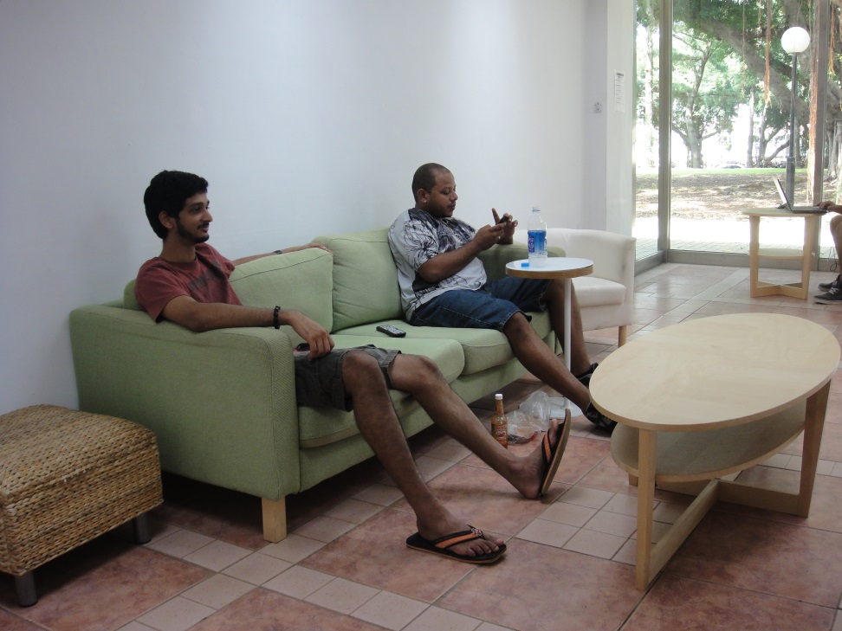
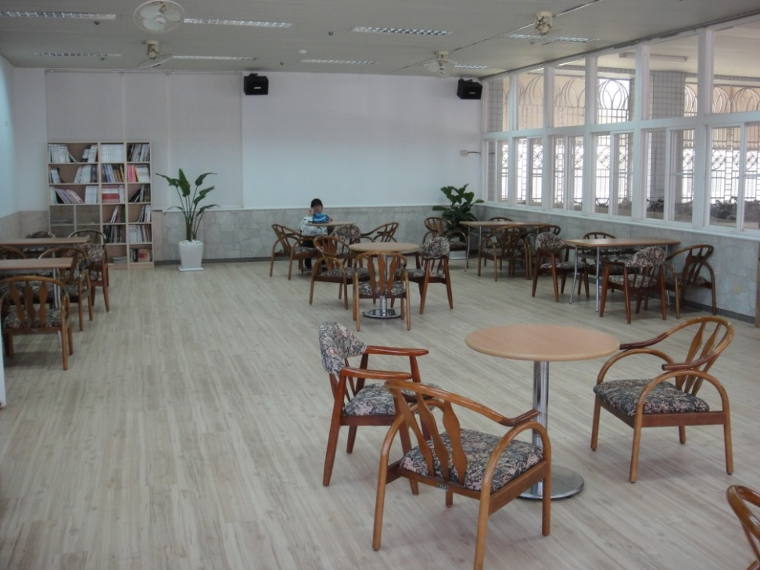
Common Room (G14)
1. Each floor has a common room.
2. The common room at 1F is 24hr and has free wifi.

Slide 13
Common Room Rules of International Student Dorm
Open Hours : 08:00 ~ 23:00
Avoid higher volume!
避免音量過大!
Avoid excessive drinking!
禁止酗酒!
Keep the place clean and neat!
保持環境清潔!

Slide 14
Important Reminder
Equipment repair
In case you need to report a damage, please go to student
page on the school website. Log in using your STD ID and
password. Once in the system, just follow the options and
we will take care of the rest. Also, please take good care of
the AC remote control, students are responsible for any
damage cause by inappropriate use or lost. The remote
control is 600NT each.
If you have further questions, please ask the dorm captains for assistant.

Slide 15
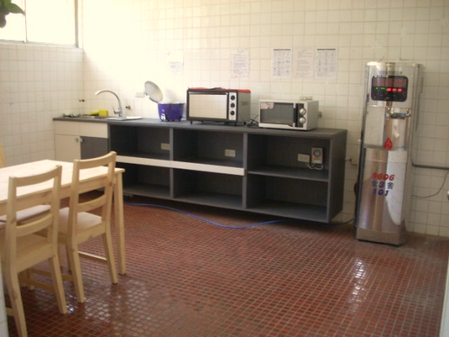
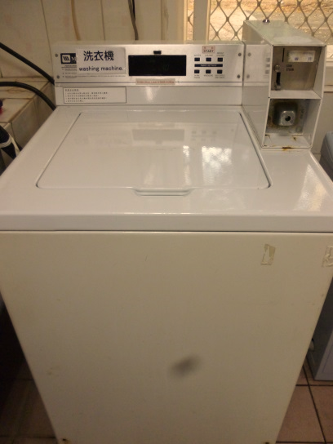
Important Reminder
Laundry (8:00 ~ 24:00)
There are water fountains, washing machines(10NT), and dryers(10NT) on each floor. If it is not functioning, please report to the dormitory service desk, we will take care of it ASAP.

Slide 16
Important Reminder
Hot water supply : 16:00 ~ 24:00
If you need a hot shower at other times, please use the bathrooms with the electric heaters.
Mail：If you are expecting mail, the correct address would be like
“Room xxx, Dorm xxx, No.300, Zhongda Rd., Zhongli Dist., Taoyuan City 320, Taiwan (R.O.C.)”

Slide 17
Mail
The Dorm Captains will put the arrival mails in the mail boxes in the common room. If you are expecting a package or a registered mail, you will need to go to the administration building to collect it yourself.

Slide 18
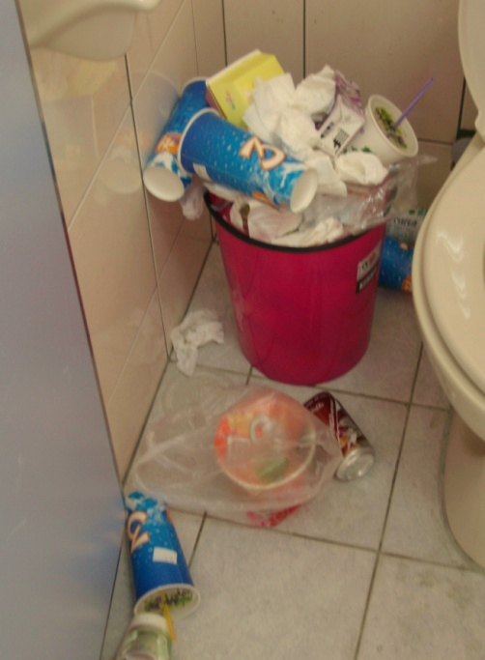
Important Reminder
Garbage & recycling trucks come at 18:40 every Mon. to Sat.
At other times, please take the garbage to the back of B9.
Please do not throw your garbage in trash cans in toilets.

Slide 19
You Must Know
Please do not use refrigerator, heater, or any oven in your own room.
Cooking in the room are strictly prohibited.
No smoking, drinking, or keeping pets on campus.
(dorms included)
4. Do not let your friends enter the dorm without applying to
the dorm captains first.
If you are going to graduate, please notify the International Affairs Office, and check out at the Dormitory Service Center.

Slide 20
You Must Know
Please do not arbitrary exchange your rooms, or give your
keys to others.
If you are injured or require special care, you may apply to
the dorm service center for an "extra care room. "
If you lost your key or card, borrow one at service desk with student ID. If you lost your Student ID, you will need to reregister ASAP.
10. Subscribe English-language newspaper dormitory,
students are free to read.

Slide 21
The Dorm Service Desk offers
1. Information of the dormitory.
2. Dorm, visitor and safety precautions.
3. Providing basal medicine.
4. Easy repair. Repair System
Helps you go to hospital at night in case of
emergency.
6. Annunciate important information.

Slide 22
Thanks for
Listening

